Slide 1


Financials through Oct 31, 2023
Monthly Financial Board Report
Prepared for: New Millennium Secondary School

Slide 2

Financial Summary
Actual to Budget:
This report is as of Oct 31, 2023, compared against our board-approved budget July 1 budget.
YTD Revenues Through Oct 31, 2023, are $591,394 or 17.5% under our current budget due to: LCFF revenues being $154,928.09 under what we budgeted – this is due to a timing of when LCFF revenues are issued Other variances include title funding and SPED revenues which we are over compared to what we projected netting to a $20,798.06 overage in these two categories combined
YTD Expenses Through Oct 31, 2023, are $1,139,780 or 22.6% over our current budget due to: Personnel expenses came in $35,235.88 over budget Space Rental/Lease expenses came in $172,194.57 largely due to incurring the lease expense upfront as well as incurring a $59,926.76 charge for Prop 39 which was discussed by Nichole in prior board meetings Educational consultants is $52,704.16 underbudget however this will come in closer to the projected total once invoices get processed
Therefore, net income is ($548,385) or 157.9% under our current budget.
Balance Sheet:
As of Oct 31, 2023, we had total cash of $2,494,434, short-term liabilities of $739,424, and long-term liabilities of $26,592. The ending fund balance is $1,797,099.
Report created on 11/8/2023 12:47:14 PM for New Millennium Secondary School

Slide 3



Understanding the Financial Health of the Organization
The chart below explains some of the parameters that the school’s leadership can evaluate to understand their financial health, and potential areas of weakness.
Cash Ratio
Ability to meet short-term obligations with cash
 | Current: | Target:
 | 337.3 % | > 100.0 %
Formula: (Cash) / (Current Liabilities)
Defensive Interval
Months of continued operation without incoming funds
 | Current: | Target:
 | 10.1 | > 2 months
Formula: (Cash + Securities + AR)/(Average Expenses for Past 12 Months)
Current Ratio (Liquidity)
Ability to pay short-term obligations
 | Current: | Target:
 | 3.4 | > 1.0
Formula: (Current Assets) / (Current Liabilities)
Report created on 11/8/2023 12:47:09 PM for New Millennium Secondary School

Slide 4
Actual to Budget Summary
FY 2023-2024, July - October
Revenue
$591,394
Expenses
$1,139,780
Surplus / (Deficit)
($548,385)
 | July - Last Closed |  |  | 2023-2024
Account Description | Actual | Budget | Variance $ | Total Budget | Actual to Total Budget % | Remaining Budget
LCFF Revenue | $481,405 | $636,333 | ($154,928) | $2,372,087 | 20.3 % | $1,890,682
Federal Revenue | $21,420 | $29,056 | ($7,635) | $165,040 | 13.0 % | $143,619
State Revenue | $58,336 | $2,556 | $55,780 | $324,071 | 18.0 % | $265,735
Local Revenue | $30,233 | $49,070 | ($18,837) | $190,242 | 15.9 % | $160,009
Total Revenue | $591,394 | $717,015 | ($125,621) | $3,051,440 | 19.4 % | $2,460,046
Certificated Salaries | $255,373 | $255,719 | $346 | $903,468 | 28.3 % | $648,095
Classified Salaries | $130,537 | $141,686 | $11,149 | $426,766 | 30.6 % | $296,229
Benefits | $169,772 | $123,040 | ($46,731) | $370,604 | 45.8 % | $200,832
Total Personnel Expenses | $555,681 | $520,445 | ($35,236) | $1,700,838 | 32.7 % | $1,145,156
Books and Supplies | $107,519 | $87,500 | ($20,019) | $292,500 | 36.8 % | $184,981
Services | $446,936 | $284,832 | ($162,104) | $852,969 | 52.4 % | $406,033
Other Outgo | $29,643 | $36,892 | $7,249 | $111,117 | 26.7 % | $81,474
Total Operational Expenses | $584,098 | $409,223 | ($174,875) | $1,256,586 | 46.5 % | $672,488
Total Expenses | $1,139,780 | $929,669 | ($210,111) | $2,957,424 | 38.5 % | $1,817,644
Net Income | ($548,385) | ($212,654) | ($335,732) | $94,016 | -583.3 % | $642,402
Report created on 11/8/2023 12:47:15 PM for New Millennium Secondary School

Slide 5
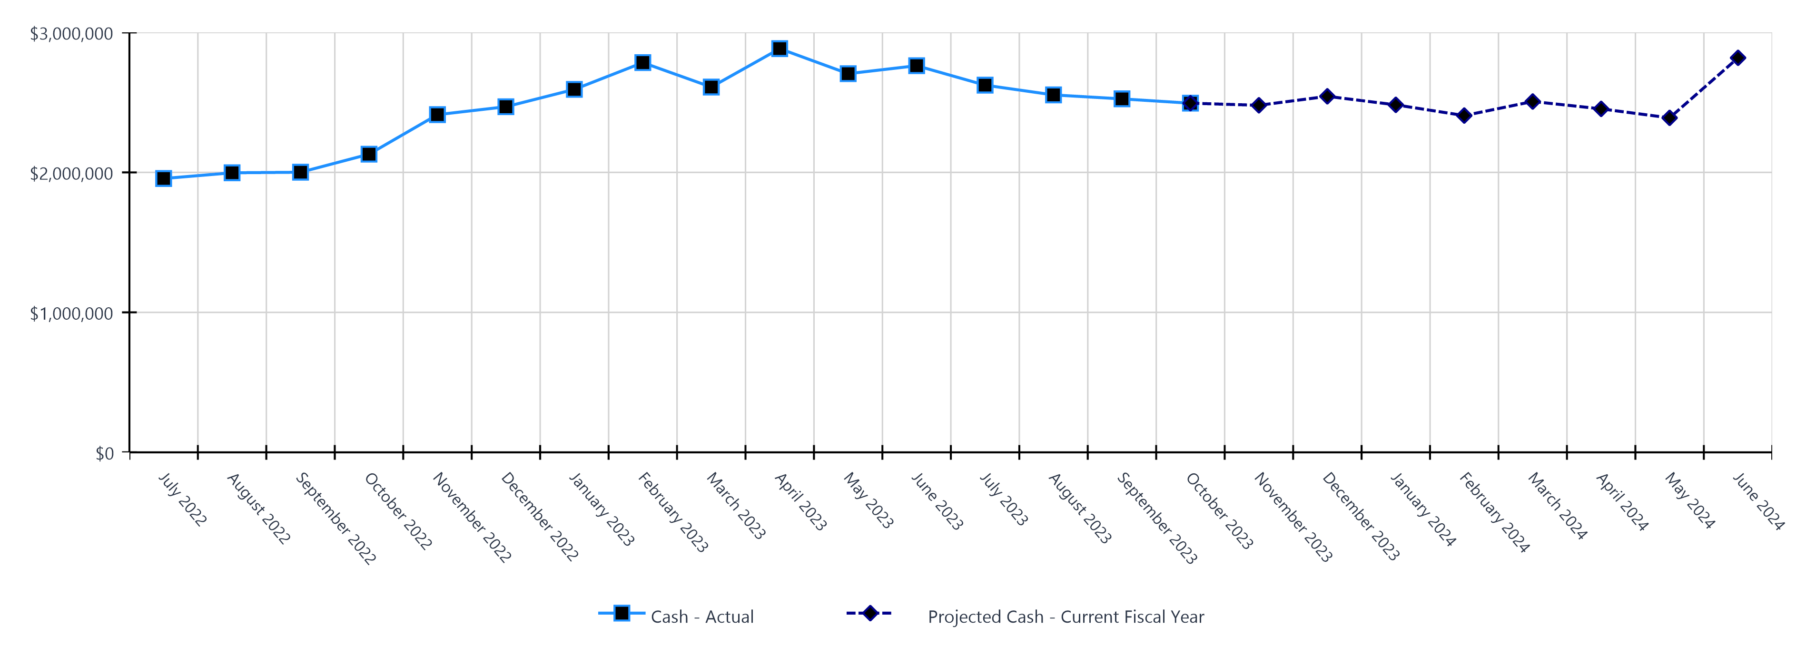
Monthly Cash Balance Over Time
Current fiscal year and prior year
 | Cash Amount | Actual or Projected
July 2022 | $1,956,307.49 | Actual
August 2022 | $1,997,146.23 | Actual
September 2022 | $2,001,150.32 | Actual
October 2022 | $2,129,907.84 | Actual
November 2022 | $2,412,549.16 | Actual
December 2022 | $2,469,092.50 | Actual
January 2023 | $2,593,072.78 | Actual
February 2023 | $2,784,315.41 | Actual
March 2023 | $2,609,773.95 | Actual
April 2023 | $2,884,071.81 | Actual
May 2023 | $2,705,357.64 | Actual
June 2023 | $2,762,272.08 | Actual
 | Cash Amount | Actual or Projected
July 2023 | $2,623,310.90 | Actual
August 2023 | $2,553,470.70 | Actual
September 2023 | $2,525,272.11 | Actual
October 2023 | $2,494,433.53 | Actual
November 2023 | $2,479,462.00 | Projected
December 2023 | $2,543,482.00 | Projected
January 2024 | $2,482,546.00 | Projected
February 2024 | $2,405,953.00 | Projected
March 2024 | $2,506,495.00 | Projected
April 2024 | $2,453,917.00 | Projected
May 2024 | $2,389,654.00 | Projected
June 2024 | $2,818,772.00 | Projected
Report created on 11/8/2023 12:47:15 PM for New Millennium Secondary School

Slide 6
Balance Sheet Summary FY 2023-2024 - October
The balance sheet displays all of the school’s assets and the school’s obligations (‘liabilities’) at a particular point in time. It is a useful way to ensure the school has enough money to pay off its debts.
Liquidity Ratio
3.4
Assets
Current Assets
Accounts Receivable | $43,204
Cash and Cash Equivalents | $2,494,434
Total Current Assets | $2,537,637
Fixed Assets
Accumulated Depreciation | ($4,736)
Fixed Assets | $30,214
Total Fixed Assets | $25,478
Other Assets
Total Other Assets | $0
Total Assets | $2,563,115
Liabilities and Net Assets
Current Liabilities
Accounts Payable | $27,183
Other Short Term Liability | $712,241
Total Current Liabilities | $739,424
Long Term Liabilities
Other Liabilities | $26,592
Total Long Term Liabilities | $26,592
Total Liabilities | $766,016
Net Increase/(Decrease in Net Assets)
Net Increase/(Decrease) in Net Assets | ($548,385)
Total Net Increase/(Decrease) in Net Assets | ($548,385)
Ending Net Assets
Ending Net Assets | $2,345,485
Total Net Assets | $2,345,485
Total Liabilities and Net Assets | $2,563,115
Report created on 11/8/2023 12:47:15 PM for New Millennium Secondary School

Slide 7

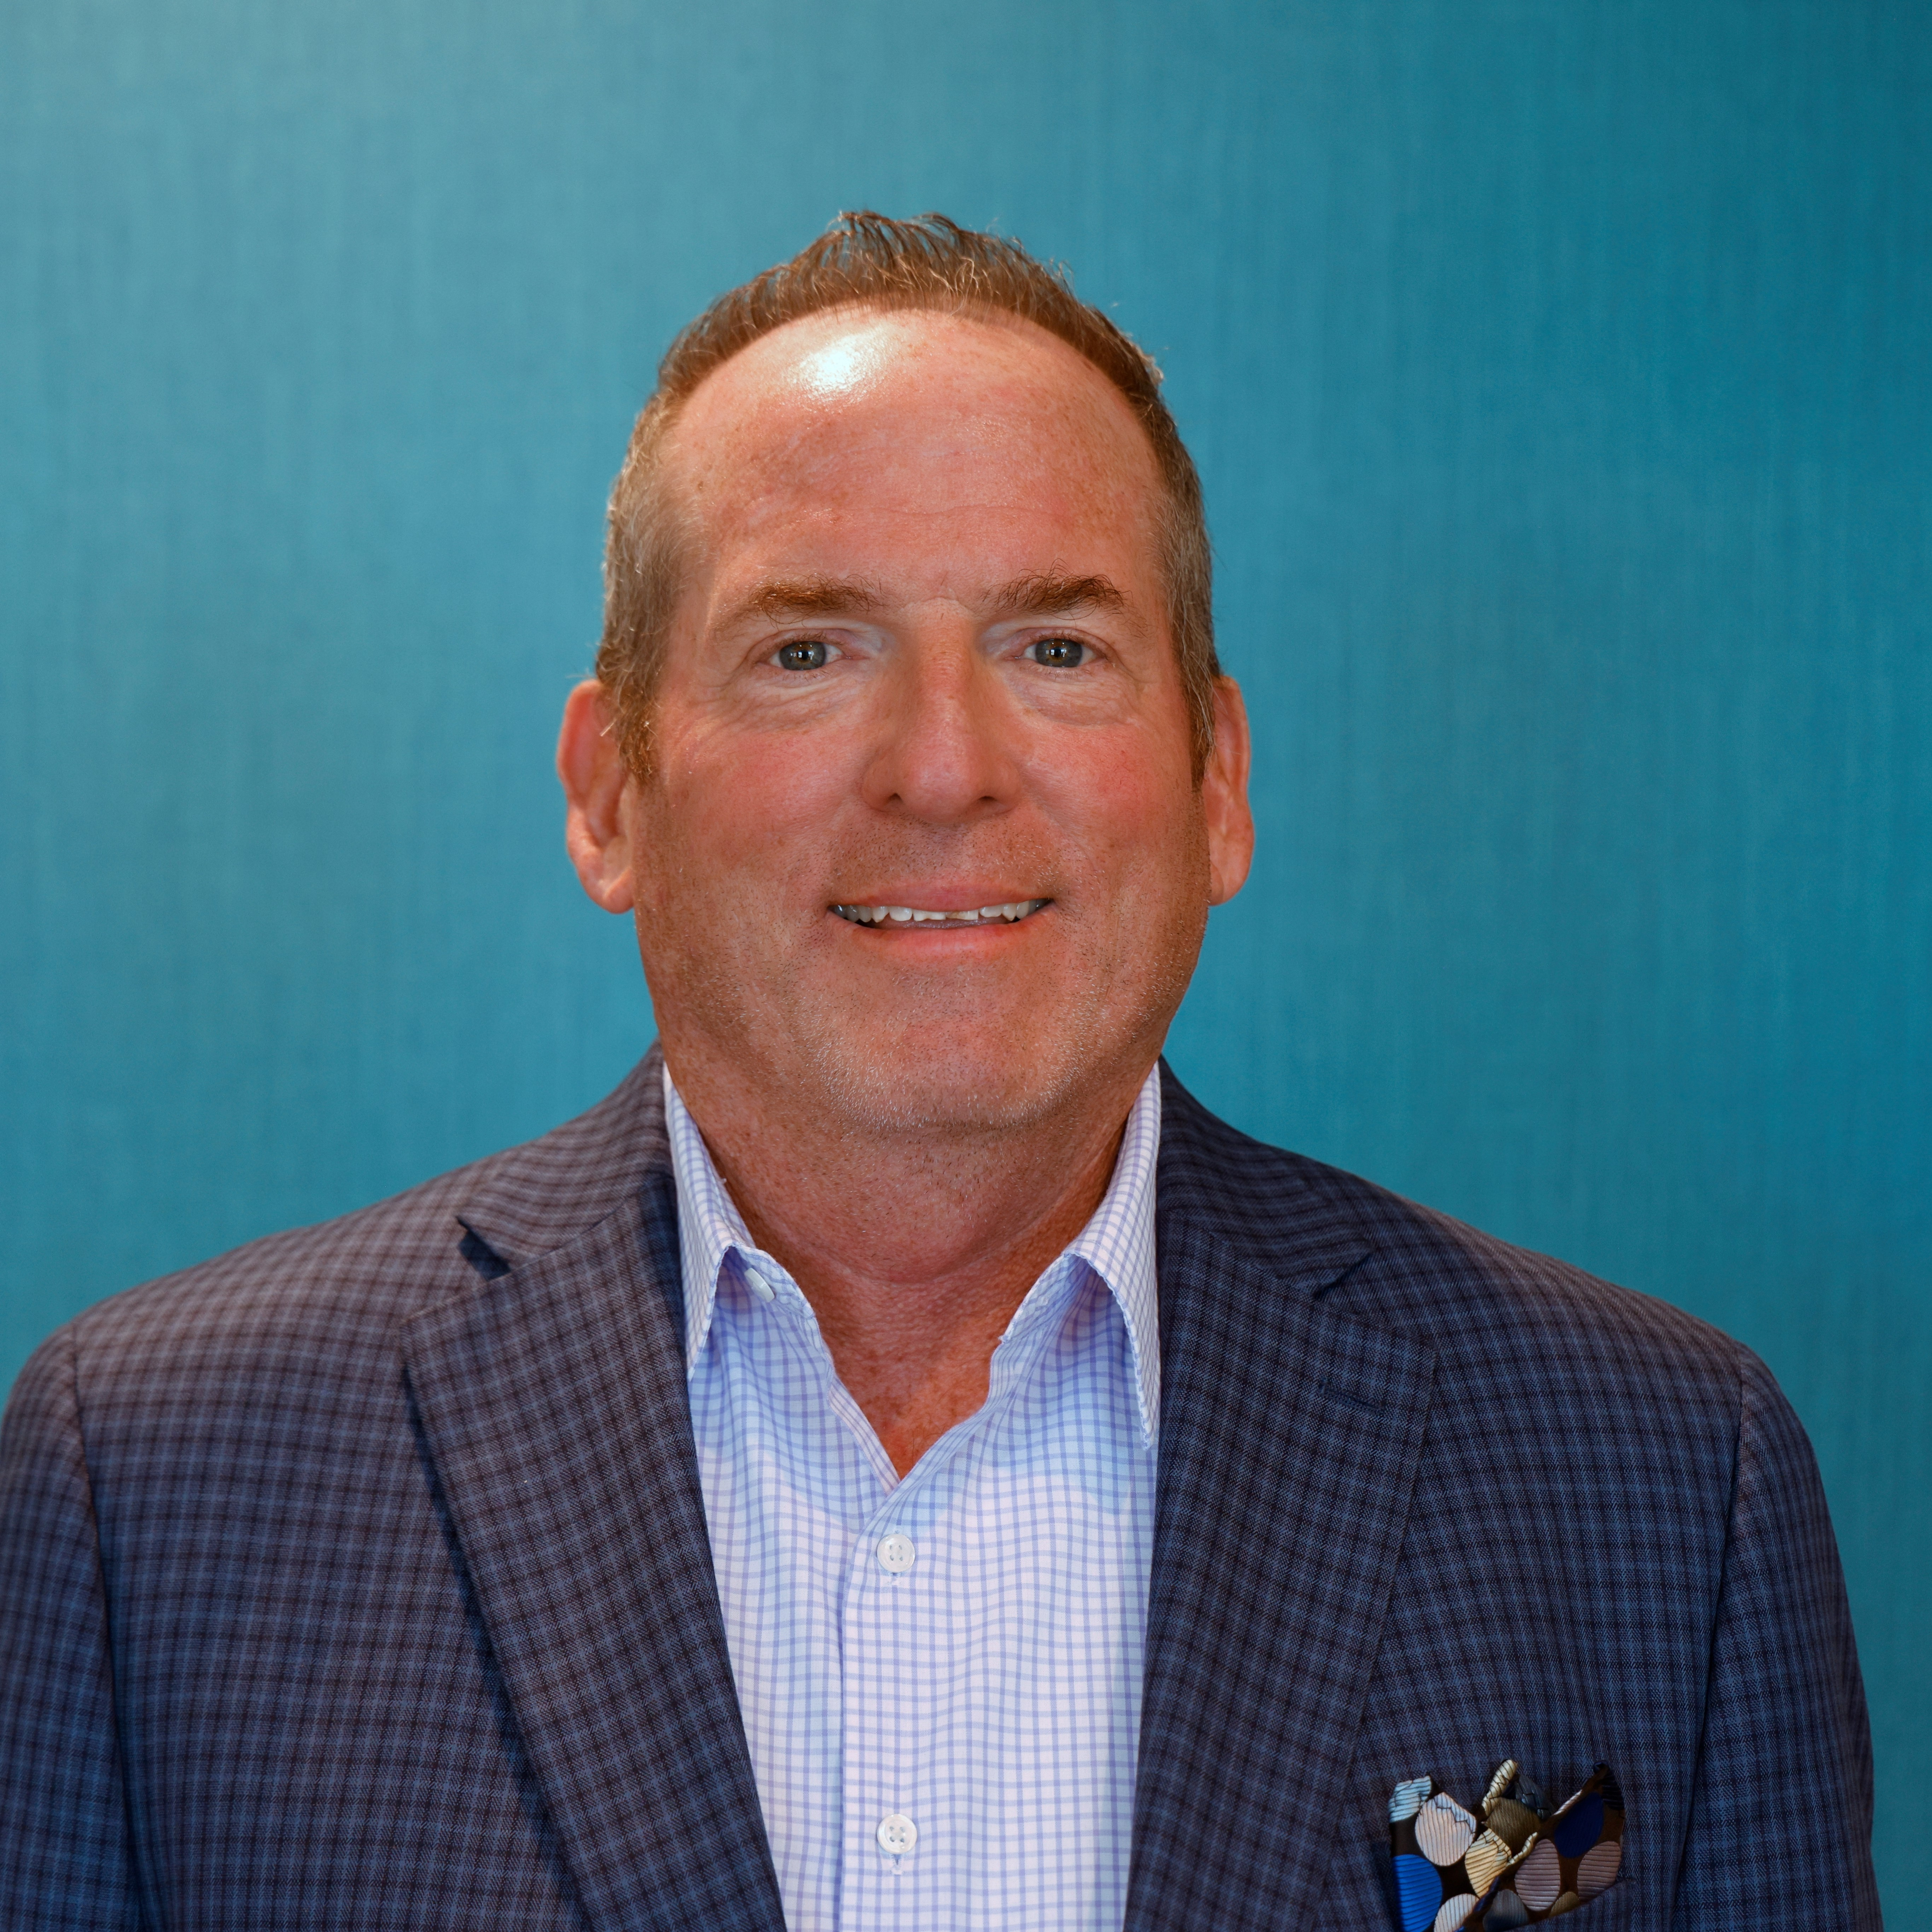


CSMC Charter School Support Team
 | Executive VP of Client Services Tom Nichols tnichols@csmci.com
 | School Business Manager Dennis Nguyen dnguyen@csmci.com
 | Divisional Director Peter Balfour pbalfour@csmci.com
 | School Business Manager Nick Miller nmiller@csmci.com
 | Account Manager Jane Folnsbee mfolnsbee@csmci.com
Report created on 11/8/2023 12:47:15 PM for New Millennium Secondary School

Slide 8
Looking Ahead
11/29/2023 | Webinar #5
11/30/2023 | UPK expenditure survey due
12/5/2023 | Workshop Topic: LCAP & Accountability Planning
12/7/2023 | Workshop Topic: LCAP & Accountability Planning
12/13/2023 | Winter Office Hours
12/15/2023 | Annual Financial Audit Report deadline
 | First Interim Financial Report
 | Learning Recovery Emergency Block Grant expenditure report
12/30/2023 | Charter School Revolving Loan applications due
1/13/2024 | CARES, ESSER, ESSER II, ESSER III expenditure report
1/15/2024 | P-1 Attendance Report
1/19/2024 | Several special education reports due; timing and steps vary by SELPA
1/24/2024 | Webinar #6
1/31/2024 | Federal Cash Management Data Collection (CMDC)
 | ASES attendance and expenditure reports
2/1/2024 | School Accountability Report Card (SARC) due in CDE portal
Report created on 11/8/2023 12:47:16 PM for New Millennium Secondary School

Slide 9

HELPING THE EDUCATION MOVEMENT SUCCEED ONE SCHOOL AT A TIME
info@csmci.com
Office: 888.994.CSMC
43460 Ridge Park Dr., Ste. 100
Temecula, Ca 92590
POWERED BY:
Report created on 11/8/2023 12:47:14 PM for New Millennium Secondary School
www.csmci.com
Charter Vision

