Slide 1


Slide 2

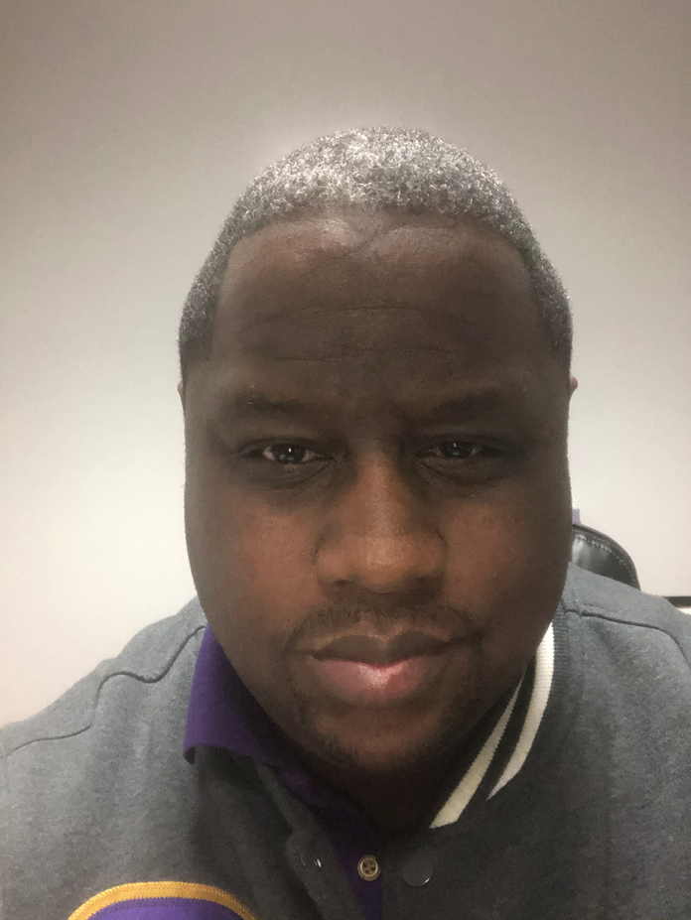



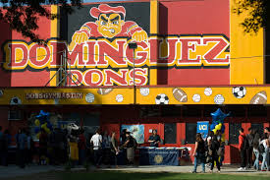






Meet the Principal
Dr. Darrick Rice
A little about me: Been an educator for the last 27 years (my first real job) I taught Social Science, Health, and P.E. I have had the pleasure of being able to have a variety of experiences and positions in education (Teacher, Football, Wrestling, and Track Coach, Athletic Director, Dean of Students, Assistant Principal, Principal, Coordinator, and Director.
I have worked as a district administrator and County Administrator, I have literally taught every grade level in some capacity. I am also an Adjunct Professor teaching single subject credentialing classes and 21st Century Learning to aspiring teacher and administrators. I also have a small educational consulting business.
I got my doctorate from Brandman University with a focus on Servant Leadership and my masters and bachelors for CSU Chico. I played college football at Western Kentucky University (Outside linebacker.)
I was born and raised in Compton, Ca and attended Dominguez High School.
Hello!!!

Slide 3

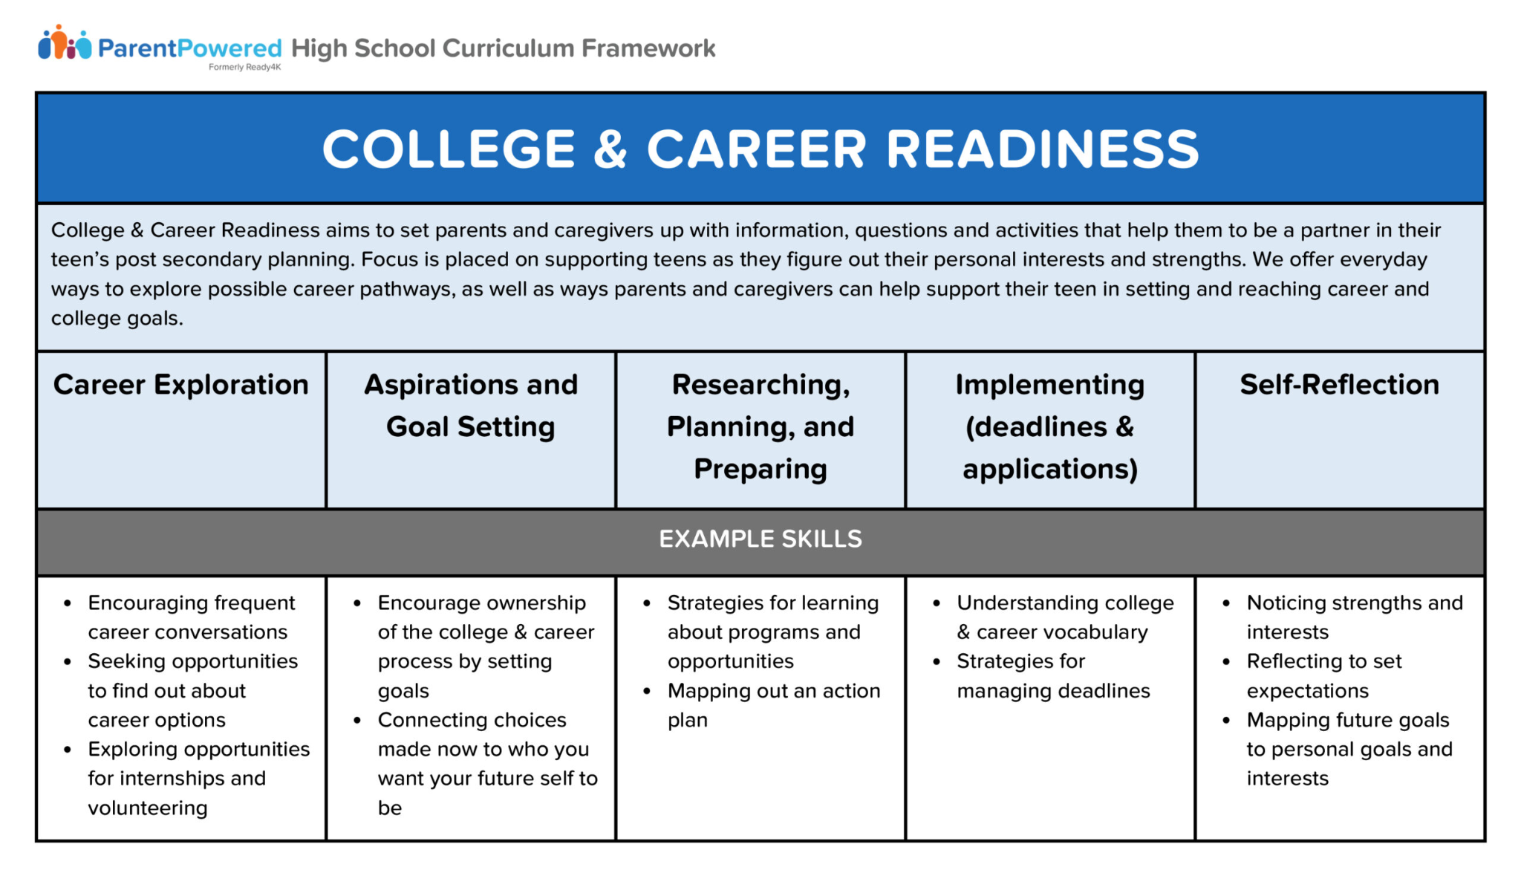

MVP-Mission, Vision, Purpose for NMSS
Our Mission: To empower every student with the knowledge, skills, and character to achieve academic excellence, pursue meaningful careers, and contribute positively to the world around them. We have to reimagine education to have a certain focus: A COLLEGE & CAREER READY FOCUS SCHOOL.
Future-ready high schools focus on preparing students for success in college, careers, and citizenship in a rapidly changing world. This involves integrating technology, fostering 21st-century skills, and providing personalized learning experiences. Key aspects include robust technology infrastructure, aligned curriculum and instruction, and data-driven decision-making to support all learners.

Slide 4
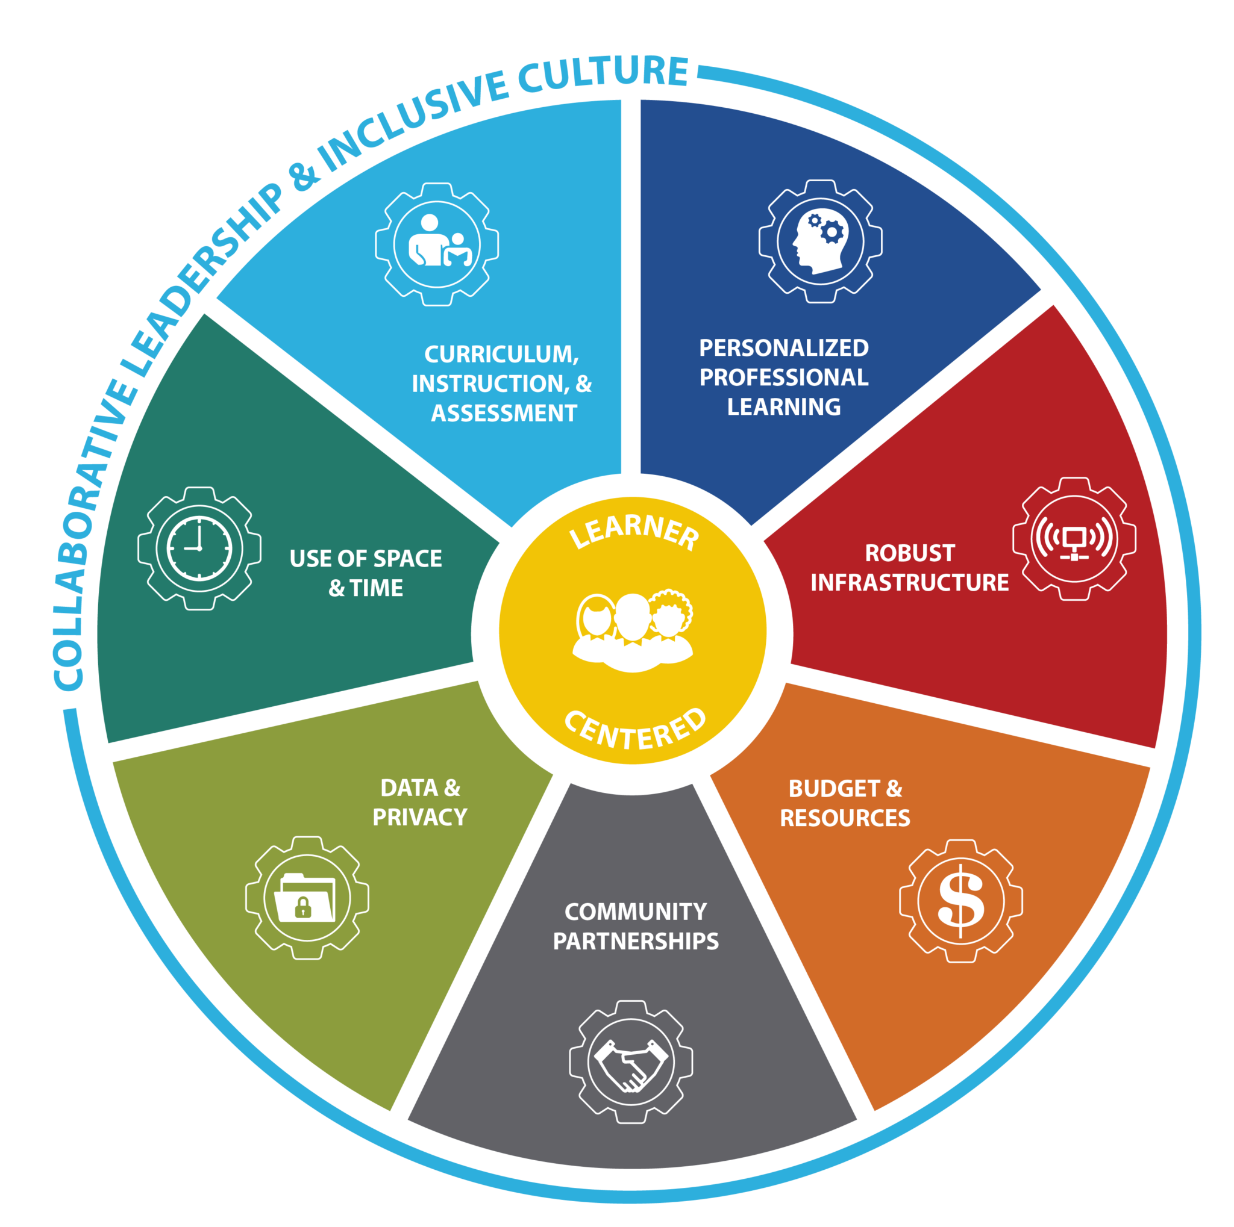
MVP-Vision
Creating community of schools where every student is challenged, supported, and inspired—where learning is rigorous, pathways are diverse, and success is defined by both achievement and growth.
We will need to move using Future Ready Curriculum that focuses on personalised learning in which students are active agents in their learning. Students are supported to follow their passions, initiate learning projects, design learning processes, and engage in solutions to authentic problems.

Slide 5
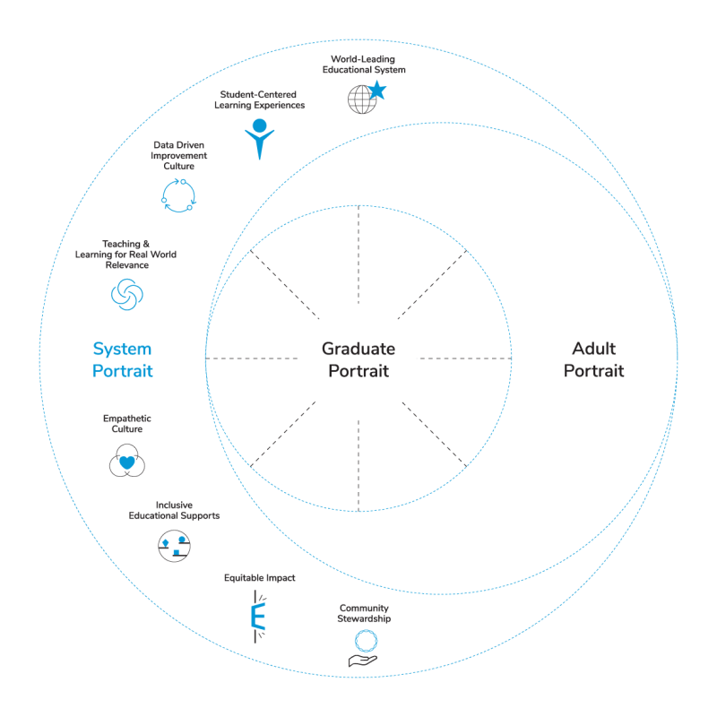
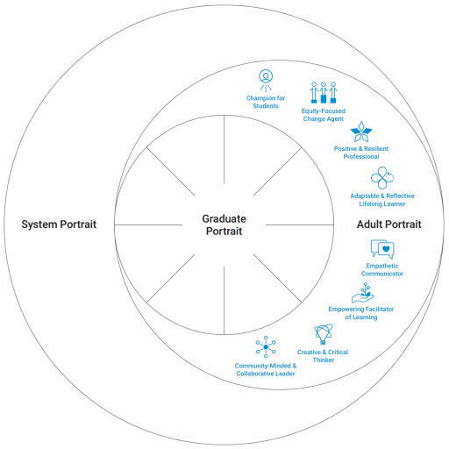
NMSS Portraits: Education Reimagined
The Adult Portrait
Widespread successful achievement of the Graduate Portrait is only possible if a supportive and intentional community of adults work together
The System Portrait
The System Portrait describes the changes needed in the school in order to create the conditions that will enable adults to attain the Adult Portrait, and support students in realizing the Graduate Portrait. This will help us to ensure that every student is future-ready, prepared to thrive in life and career when they graduate from NMSS

Slide 6
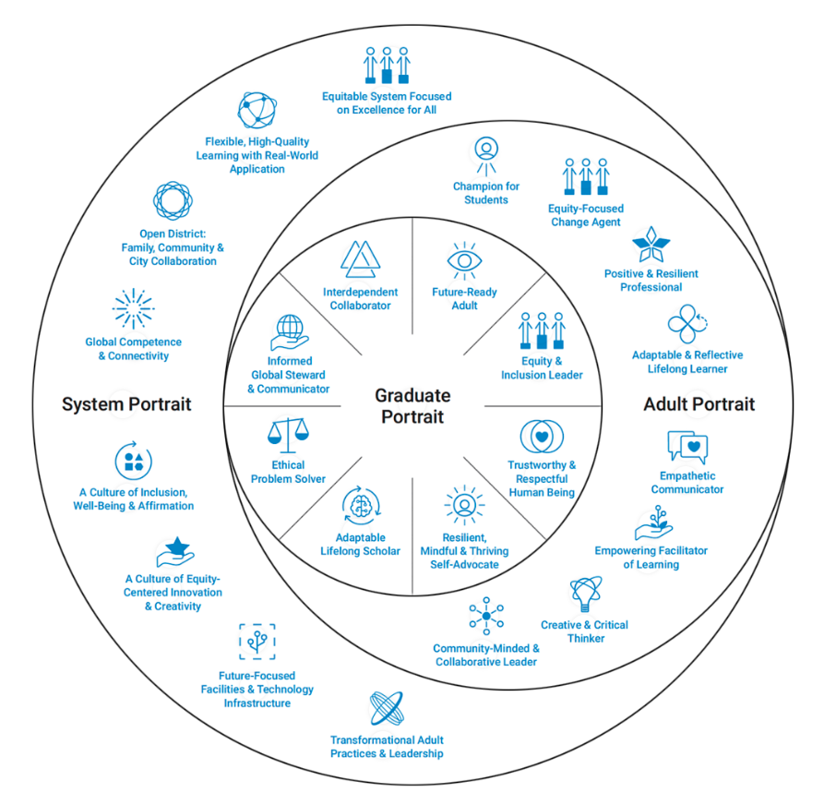
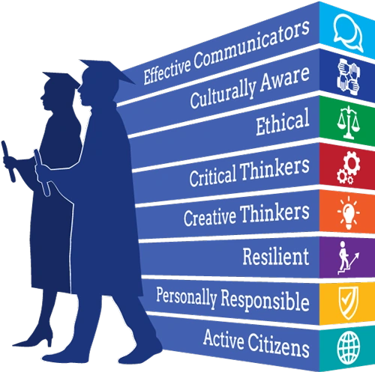
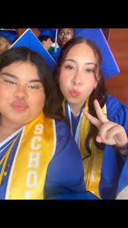
Portrait of a Graduate
The Graduate Portrait
The Graduate Portrait envisions the outcomes for students—the community’s aspirations for what graduates will know, be and be able to do to thrive in their lives and careers.

Slide 7


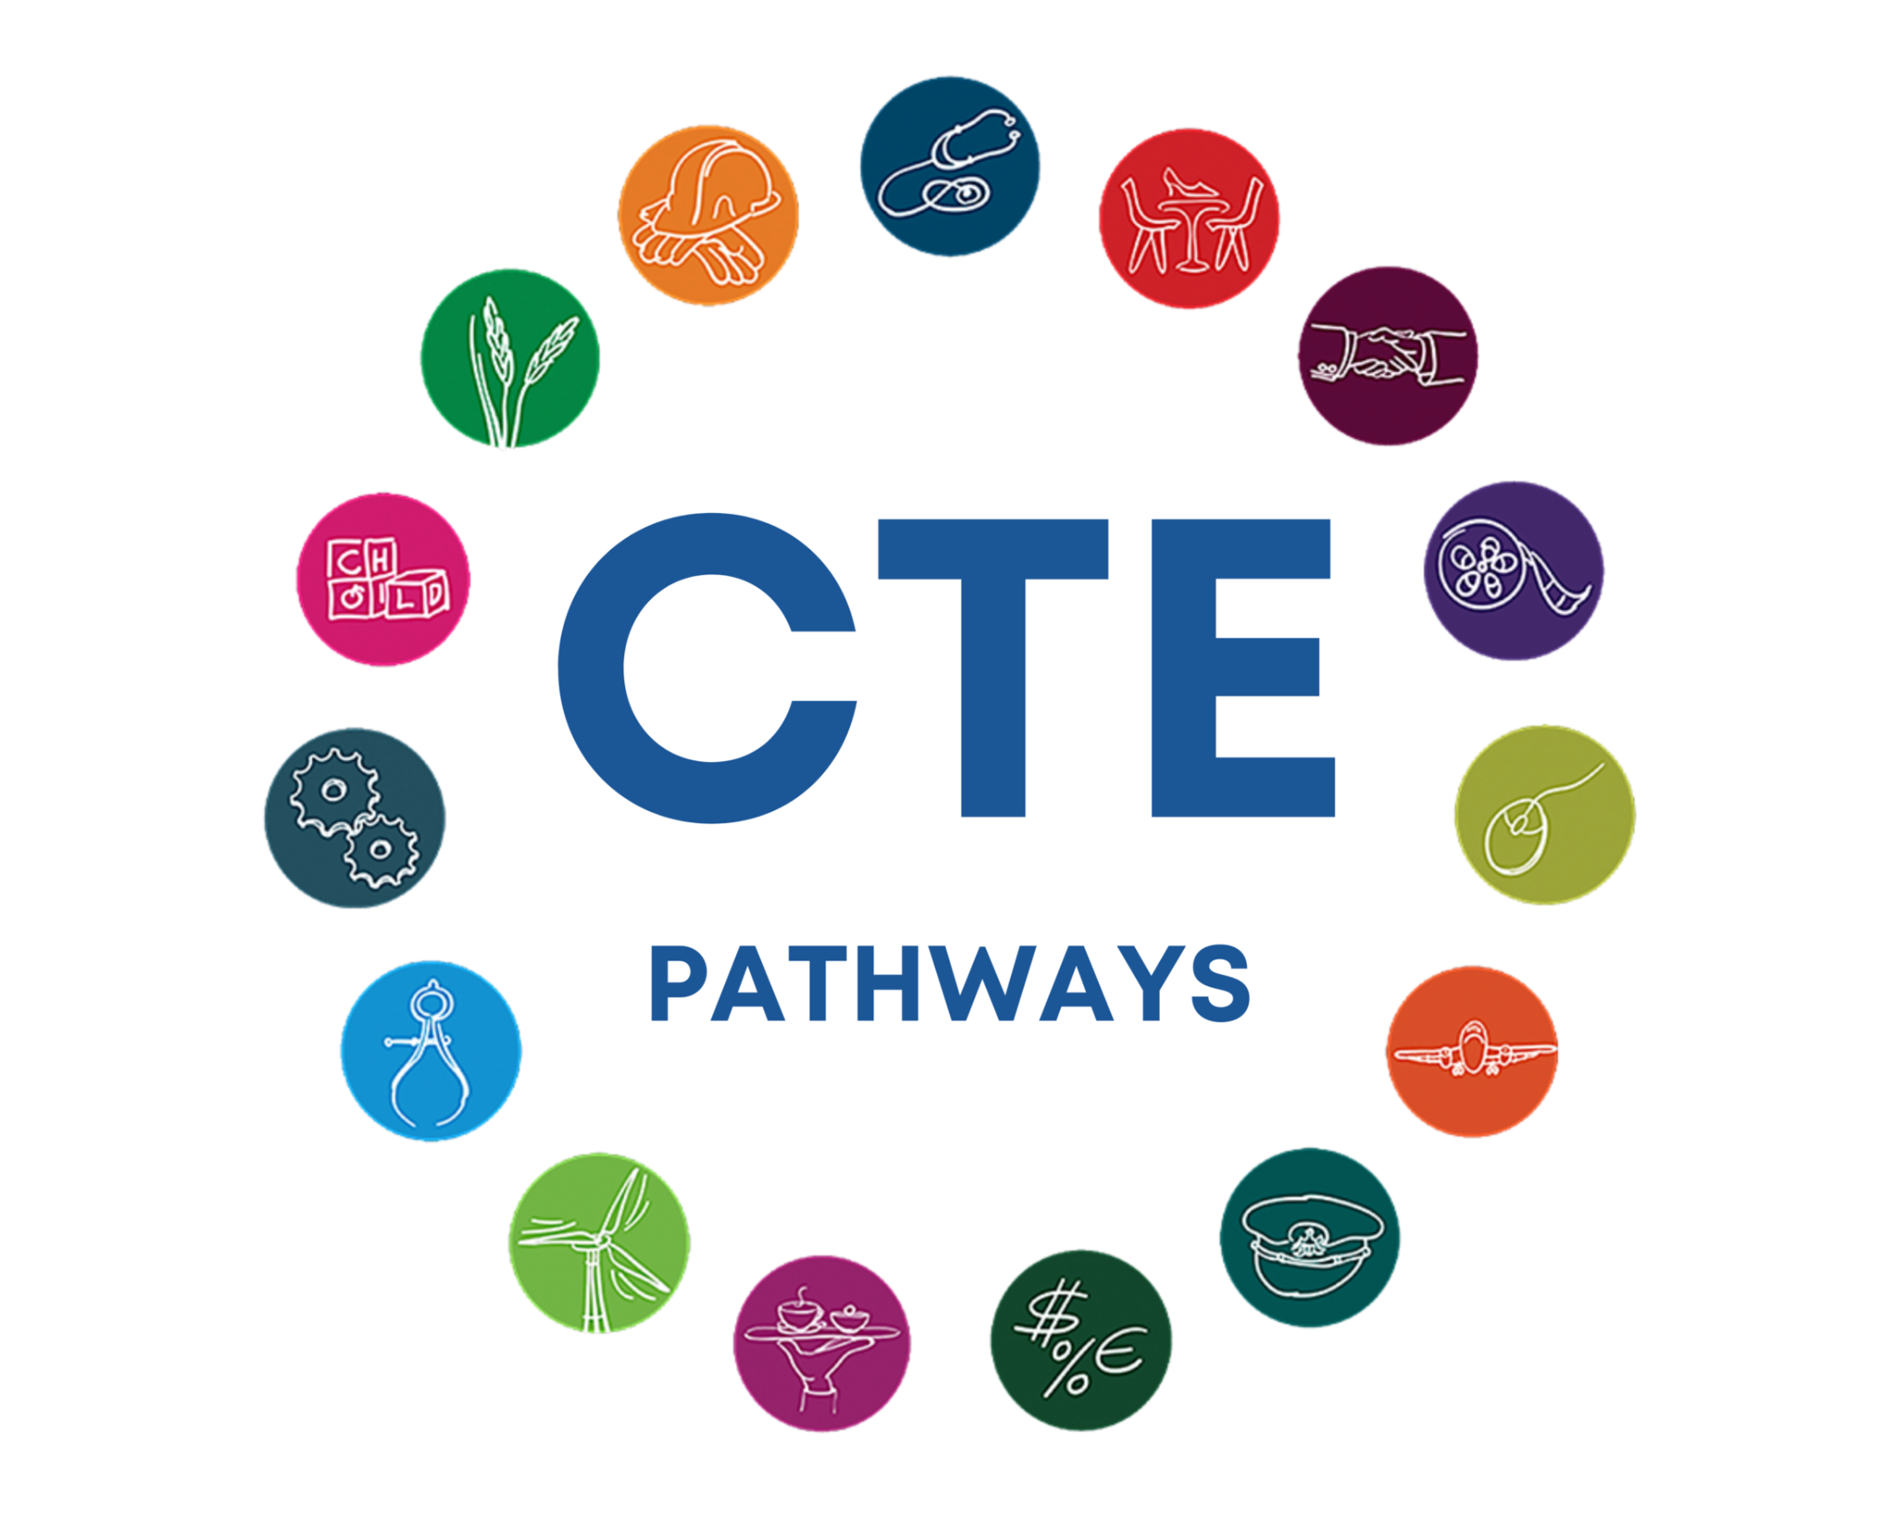
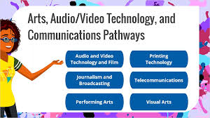
CTE Pathways & CTE Focuses

Slide 8
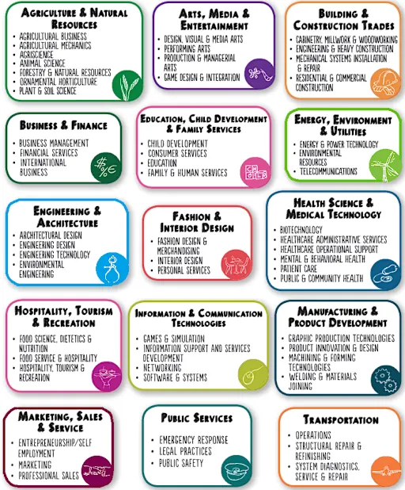
Other CTE Pathways

Slide 9



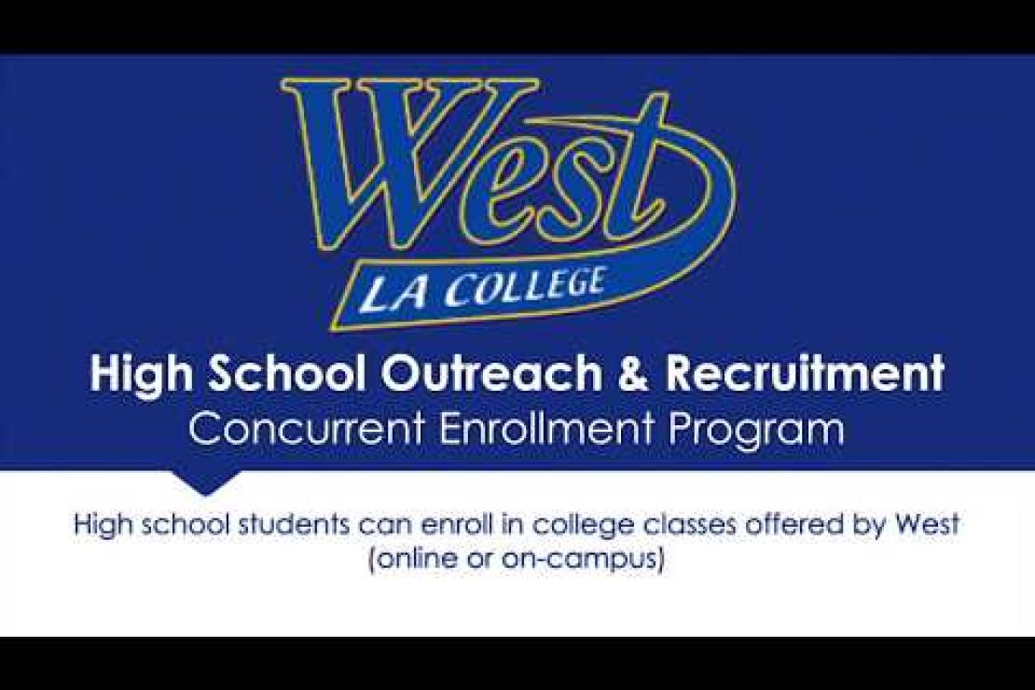
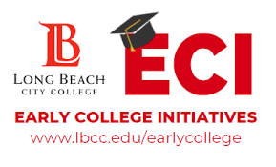



Dual Enrollment Classes coming soon

